Slide 1
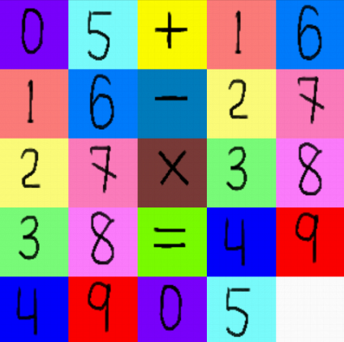
Team 6
The CrazyPuzzle Team

Slide 2

Team Members
Brent Dombrowski – puzzle grid, problem difficulty
Hema Kumar – puzzle grid, tile drawing
Derek Qian – puzzle grid, tile movement,
tile drawing
Frank Sliz – tile scrambling

Slide 3
Status of Current Sprint
Setup java JDK, eclipse IDE, and Android SDK for Android 2.2 and 2.3 development
Setup GitHub repository
Held weekly planning meetings
Coded initial version of puzzle in mode 1
Tiles are labeled and tiles can be moved
Developed strategy for problem difficulty
Developed initial code for scrambling of tiles

Slide 4
Goals for Next Sprint
Add tile scrambling and unscrambling
Add dragging gesture for equation selection
Add equation validation and scoring
Add difficulty selection
Handle pausing and end of game
Start development of puzzle in mode 2

